Slide 1

PROJECT PROPOSAL PRESENTATION
TIME SERIES FORECASTING FOR ENERGY CONSUMPTION IN MALAYSIA USING REGRESSION TECHNIQUE
PRESENTED BY : NURAMIRA SHAFINAZ BINTI ZULAILEE
MATRIC NO : MCS231031
VENUE : DISCUSSION ROOM 4, LEVEL 2, BLOCK N28A
DATE : 25TH JULY 2024
LECTURER : ASSOC. PROF. DR MOHD SHAHIZAN BIN OTHMAN

Slide 2
INTRODUCTION

Slide 3
BACKGROUND
Malaysia's energy landscape has undergone significant changes over the past few decades.
The country's energy sector, characterized by a diverse mix of fossil fuels (natural gas, coal, oil) and renewable energy sources (hydropower, solar, biomass), has seen substantial growth in demand due to industrial expansion, urban development, and population growth.
Accurate forecasting is essential for ensuring energy security, economic efficiency, and environmental sustainability.

Slide 4
PROBLEM STATEMENT
Forecasting energy consumption in Malaysia presents several challenges. Economic growth, technological advancements, climate variations, and policy changes all impact energy demand. Traditional forecasting methods often need to capture these complexities, leading to inaccurate predictions. Accurate forecasts are vital for managing energy demands, preventing deficits and wastage, and formulating effective energy policies.

Slide 5
RESEARCH QUESTIONS & OBJECTIVES
Research Question
Research Objectives
RQ 1: How effective are different regression techniques (linear, polynomial, multiple linear regression) in forecasting energy consumption in Malaysia?
RQ2: How do advanced regression models compare to traditional time series forecasting methods regarding accuracy and reliability?
RQ 3: What are the potential impacts of implementing energy efficiency measures on future energy consumption in Malaysia?
RQ 4: What are the potential future trends in energy consumption in Malaysia based on current data and regression model predictions?
Data Analysis: To collect and analyse historical data on energy consumption in Malaysia to identify trends, patterns, and seasonal variations.
Model Development: To develop regression models (linear, polynomial, multiple linear regression) for forecasting future energy consumption in Malaysia.
Model Evaluation: To evaluate the performance of different regression models using metrics such as Mean Absolute Error (MAE), Mean Squared Error (MSE), and Root Mean Squared Error (RMSE).

Slide 6
SCOPE OF THE STUDY
Data will be sourced from reputable national and international databases, including the Energy Commission of Malaysia, the Department of Statistics Malaysia, Tenaga National Berhad, the Climate Change Knowledge Portal and global organizations such as the International Energy Agency (IEA) and the World Bank.
The study will incorporate various types of data, such as total energy consumption, sector-specific consumption, economic indicators (GDP), consumer price index (CPI), demographic data (population growth), and climatic variables (temperature, humidity).
Different types of regression analysis, such as linear regression, polynomial regression, and multiple linear regression will be applied.
Model evaluation metrics like Mean Absolute Error (MAE), Mean Squared Error (MSE), and Root Mean Squared Error (RMSE) will be used, and cross-validation techniques will be employed to ensure the models’ reliability and applicability are tested.

Slide 7
LITERATURE REVIEW

Slide 8
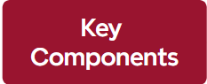
LITERATURE REVIEW
Regression Techniques and Their Application in Time Series Analysis
Definition & Concept Time Series
Linear Regression
Polynomial Regression
Multiple Regression
Regularization technique
Trends
Seasonality
Noise
Energy Consumption Trends in Malaysia
Increasing rapidly due to economic
development, industrialisation,
and urbanisation.
population growth in the urban area
high use of energy on-premises
Industrial growth triggered high commercial
and industrial energy usage.
Key Influencing Factors on Energy Consumption
Economic Factors
Demographic Factors
Climatic Factors

Slide 9
METHODOLOGY

Slide 10
DATA SCIENCE LIFE CYCLE
Problem Identification
Data Collection
Data preprocessing
Exploratory Data Analysis (EDA)
Data Modelling
Model Evaluation
Deployment

Slide 11
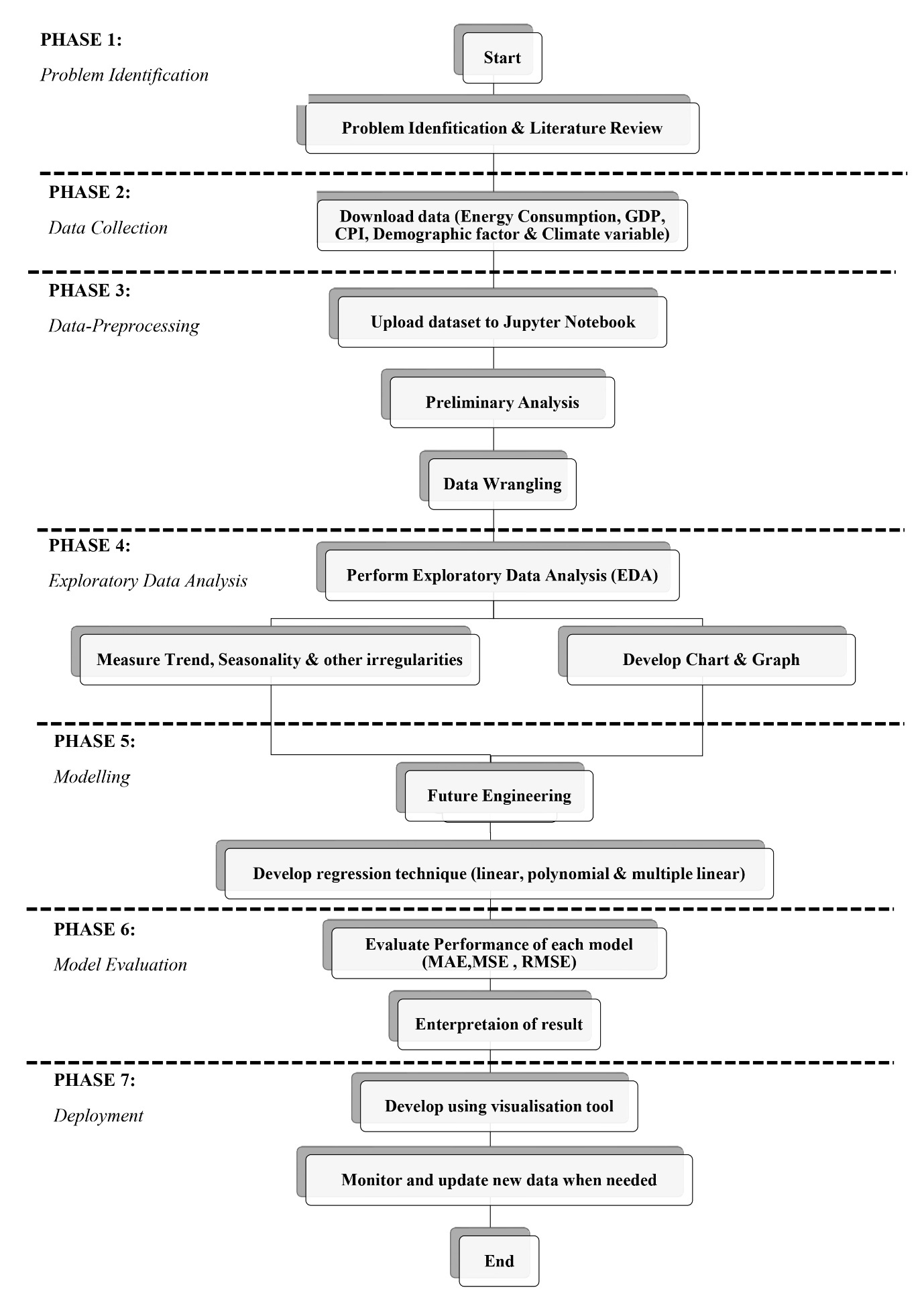
A research framework for time series forecasting of
energy consumption using Regression methods

Slide 12
DATA SOURCES AND COLLECTION METHODS
Energy Commission of Malaysia (Suruhanjaya Tenaga)
Provides detailed reports and statistics on energy consumption by sector, including residential, industrial, and commercial energy use.
Tenaga Nasional Berhad
Provides details about the electricity consumed in Malaysia.
Climate Change Knowledge Portal
Provide details about climate variables such as temperature and humidity
World Bank and International Energy Agency (IEA)
Department of Statistics Malaysia (DOSM)
This agency offers economic and demographic data, such as GDP, population growth, and urbanization rates.
Provide global economic indicators and comprehensive energy statistics.

Slide 13
DATA CLEANING
Handle missing values within the dataset.
Remove the duplicate data. It is essential to check and eliminate duplicate data to avoid redundancy and ensure that the data is unique.
Outlier detection and treatment are other essential aspects of data cleaning. These are treated to prevent them from skewing the analysis, and this can be done either by removing them or capping their values to a more reasonable range

Slide 14
FUTURE ENGINEERING
Generate lagged variables to capture temporal dependencies in time series data
Create interactions between features to capture the combined effects
Develop polynomial features to non-linear relationships, calculate rolling to smooth out the short-term fluctuations
Create dummy variables to capture seasonal effects such as months, quarters, or seasons.

Slide 15
VISUALISATIONS
Time Series Plots
Separate plots for different sectors will be created to identify the consumption patterns.
A time series for energy demands by sector in Malaysia may reveal increases in usage during a specific time.
Correlation Heatmaps
A heatmap will display the correlation between energy consumption in Malaysia and various economic, demographic, and climatic variables.
Strong positive correlation between GDP and energy consumption would indicate that economic growth drives higher energy usage, and population growth leads to higher energy consumption.
Scatter Plots
This will examine the relationship between energy consumption and key predictors such as GDP, population growth, temperature, and humidity.
plotting energy consumption in Malaysia against GDP can reveal whether there is a linear relationship (indicating GDP increases so with the energy consumption) or to see if there are non-linear patterns.
Box Plots
The box plot will visualize the distribution of variables such as energy consumption, GDP, economic factors, and climate variables.
It will help to identify the outliers and understand the spread and central tendency of the data.
Histograms
Assess the distribution of individual variables, such as energy consumption, GDP, and temperature.
a histogram of energy consumption might reveal a right-skewed distribution, indicating that a few periods have exceptionally high consumption.

Slide 16
INITIAL INSIGHTS
Identification of long-term trends in various energy consumption in Malaysia, such as the pattern of increases or decreases.
Strong correlations between energy consumption in Malaysia and economic factors such as GDP, industrial and residential.
Differences in energy consumption patterns across residential, industrial, and commercial sectors.
Trends and Seasonality
Relationships Between Variables
The impact of climatic factors such as temperature and humidity on energy usage in Malaysia.
Sector-Specific Insights
Identification of high-consumption periods and potential causes.

Slide 17


THANK YOU
utmofficial
univteknologimalaysia
utm.my

